Slide 1
Objects in JavaScript
Exploring Objects with Arrays, Looping, Properties, and Methods

Slide 2
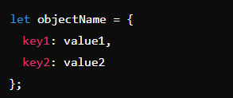
Introduction to Objects
Definition: Objects are collections of properties, where each property is a key-value pair.
Syntax :

Slide 3
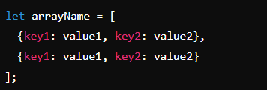
Objects with Arrays
Objects in Arrays: Arrays can contain objects as elements.
Syntax :

Slide 4
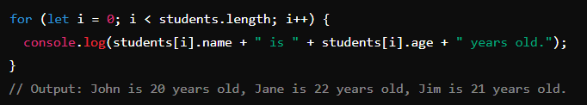
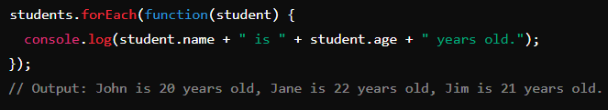
Looping Through Arrays of Objects
Using for loop:
Using forEach loop:

Slide 5
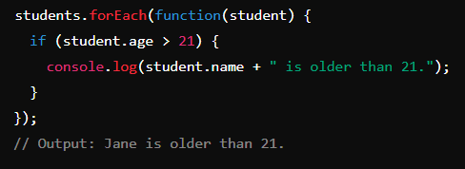
Accessing Objects with Loops and Conditions
Condition within Loop:

Slide 6
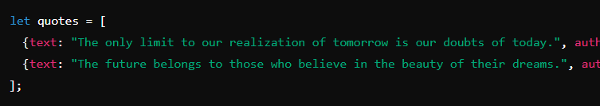

Making Quotes with Objects
Creating Quote Objects :
Displaying Quotes :

Slide 7


Object Properties
Definition: Properties are key-value pairs associated with an object.
Syntax :
Example :

Slide 8

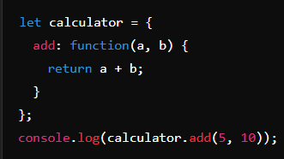
Object Methods
Definition: Methods are functions that are properties of an object.
Syntax :
Example :

Slide 9
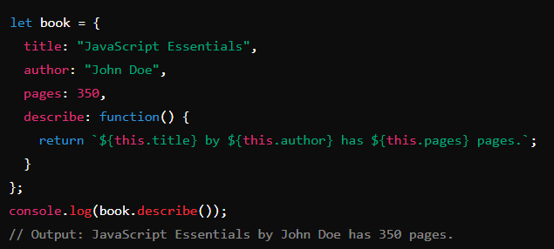
Combining Objects and Methods

Slide 10
Summary
Key Points:
Objects can store complex data with properties and methods.
Arrays can hold multiple objects.
Looping and conditions can access and manipulate objects within arrays.

